Slide 1


EDA On
BILLIONAIRES
PRESENTED BY:
JANANI JENNIFER

Slide 2




CONTENT
INTRODUCTION
SYSTEM DESIGN
IMPLEMENTATION
CONCLUSION

Slide 3
INTRODUCTION
The Aim of the project to give Data analysis on Top Billionaires in the World
The World's Billionaires is an annual ranking of people who are billionaires
A billionaire is a person with a net worth of at least one billion

Slide 4

EDA ON
BILLIONAIRES
This data set consists of information.
Rank
Name
Networth
Age
Country
Source
Imdustry
Age_Group
The EDA consists of 7 columns. Here we have 7 features using this we start data analysis of BILLIONAIRES in India.

Slide 5
SYSTEM DESIGN
Bussiness understanding
Data collection
Data cleaning
Data Visualization
Descriptive analysis

Slide 6




IMPLEMENTATION
Import Required Libraries:
#code
import pandas as pd
import numpy as np
import matplotlib.pyplot as plt
import seaborn as sns
from wordcloud import WordCloud, STOPWORDS
import warnings
warnings.filterwarnings('ignore')

Slide 7
Data Preprocessing
Loading Data:
df=pd.read_csv("G:\datascience\Forbes Billionaires.csv")
Shape Of Dataframe
df.shape
o\p
(2600, 7)

Slide 8

Data cleaning
Checking for missing values
#code
df.isnull().sum()
No Missing values Found!! It looks like data is already pre-processed so we can jump directly to EDA.
Rank 0
Name 0
Networth 0
Age 0
Country 0
Source 0
Industry 0
dtype: int64

Slide 9

EXPLORATORY DATA ANALYSIS

Slide 10

Q1.
Top 10 Countries with Most Billionaires

Slide 11
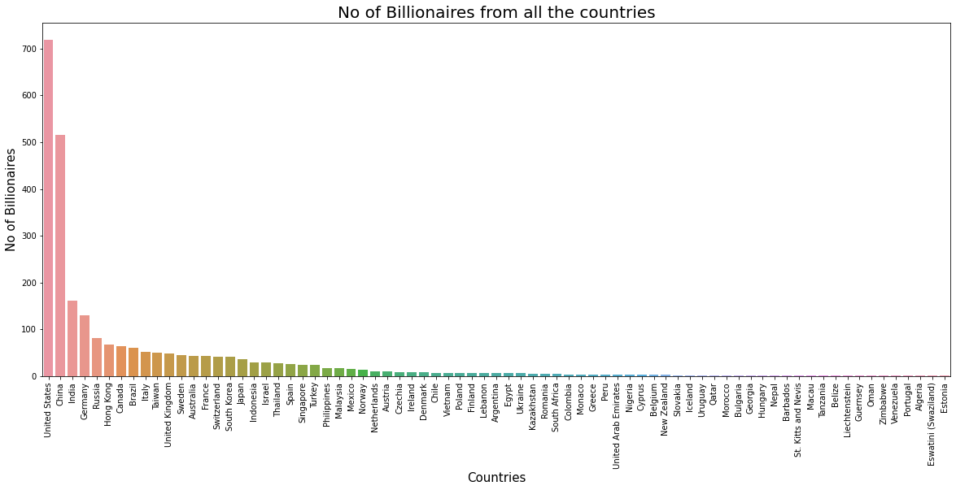
United States has the high number of Billionaires

Slide 12
Q2.
Is the country with the most billionaires the one
with the most wealth?

Slide 13
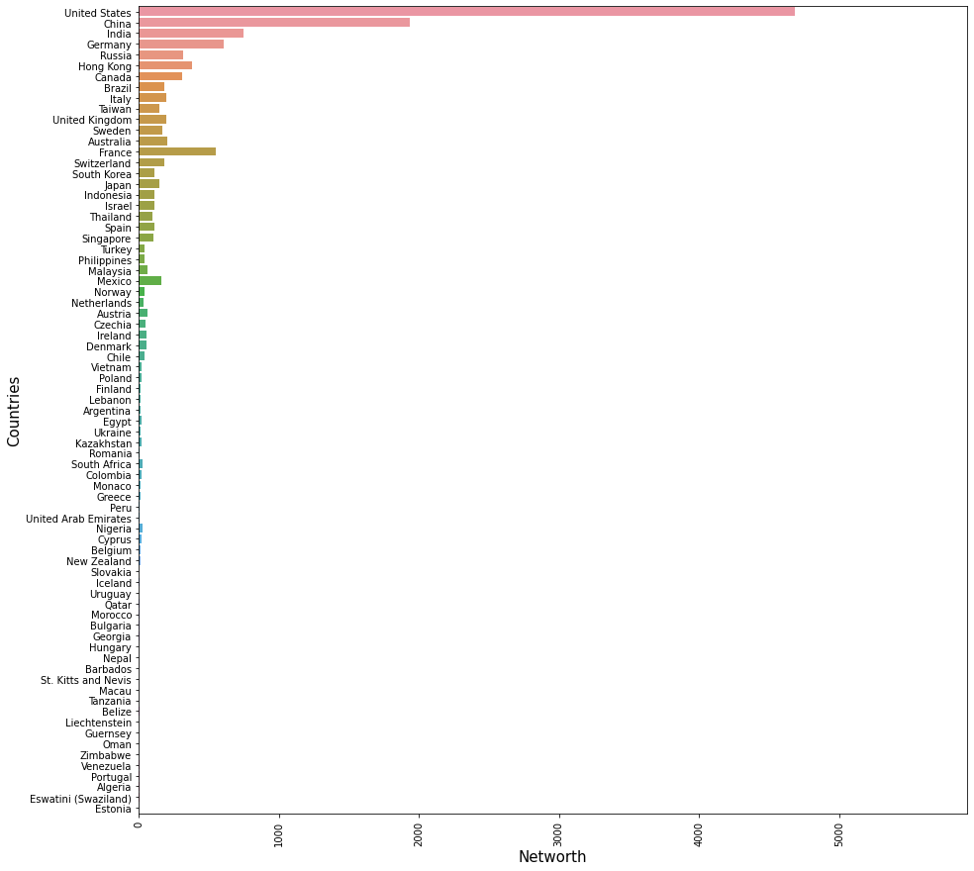
The answer seems to be yes but we can see that France has more money than countries which have more billionaires since it's sorted by the number of billionaires in the chart.

Slide 14
Q3.
How old are Billionaires?

Slide 15
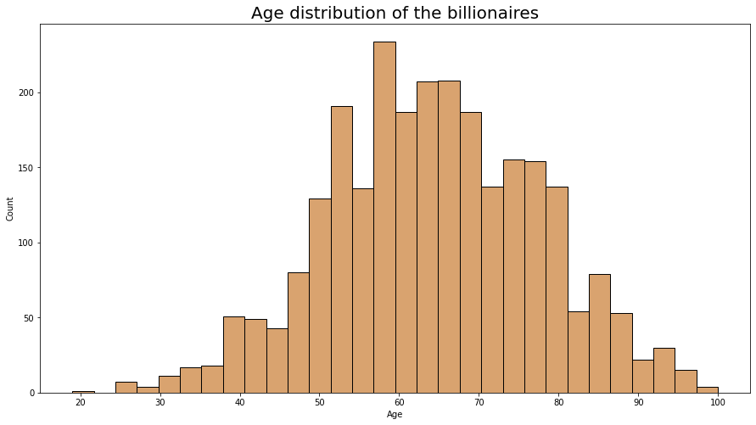
Most of the Billionaires belongs to 50-70 years of age group. lets check who is youngest billionaire.

Slide 16

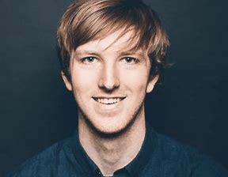
Who is the Youngest Billionaire?
Kevin David Lehmann is a german investor. He is best known as the son of German billionaire Guenther Lehmann, who made his fortune by investing in a drugstore. He first hit the headlines in 2021 when he turned 18 after Forbes listed him as the youngest billionaire worldwide.

Slide 17

Q5.
Age Group of Billionaires?

Slide 18
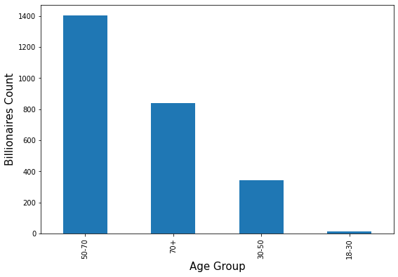
Most of the Billionaires are of 50 or more than 50 years old.

Slide 19
Q6.
What billionaires do?

Slide 20
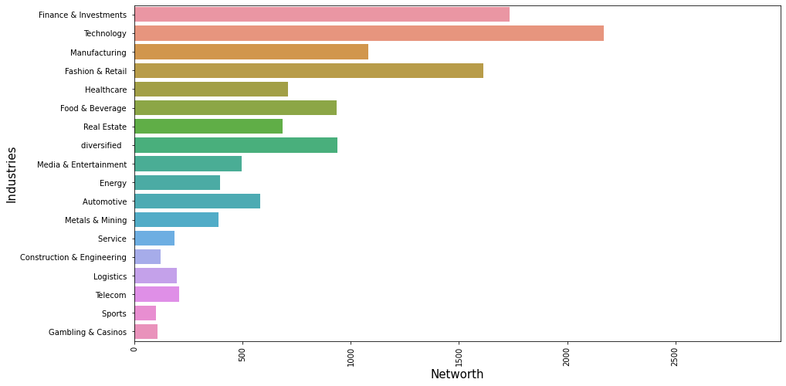
MOST OF THE BILLIONAIRES WORK ON TECHNOLOGIES

Slide 21
Q7.
Where does this money come from ( Source of Billionaires ) ?

Slide 22
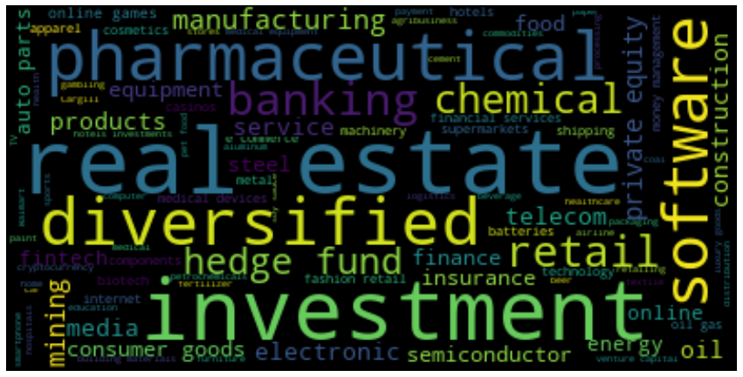

Slide 23
Q8.
Top 5 Billionaires from India ?

Slide 24
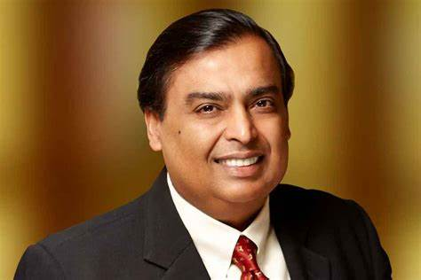
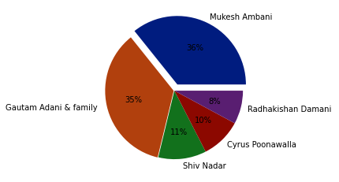
Mukesh Ambani is the Top Billionaire in India

Slide 25










Q9.
Top 5 Billionaires from United States ?

Slide 26
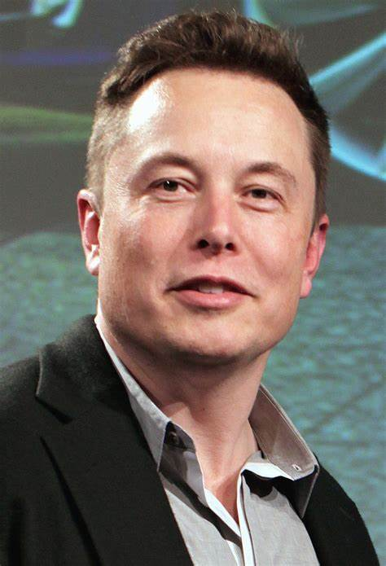
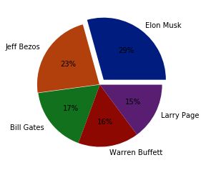
Elon Musk is the Top Billionaires in United States

Slide 27
Q10.
Top 5 Billionaires from China ?

Slide 28
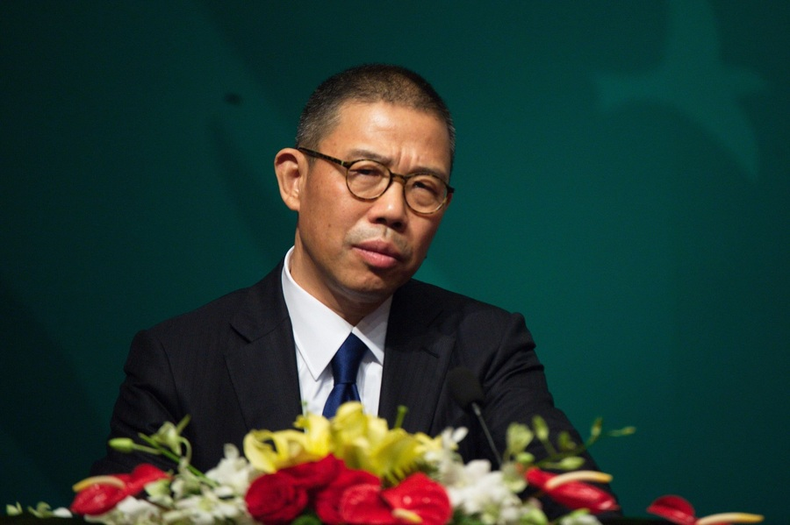
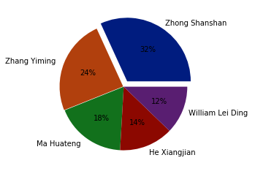
Zhong Shanshan is the Top Billionaires in China

Slide 29
Q11.
Top 5 Billionaires from Russia

Slide 30
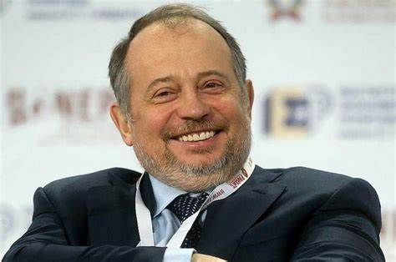
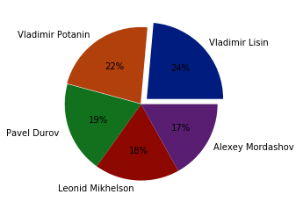
Vladimir Lisin is the Top Billionaires in Russia

Slide 31

Q12.
Top 5 Billionaires from Germany

Slide 32
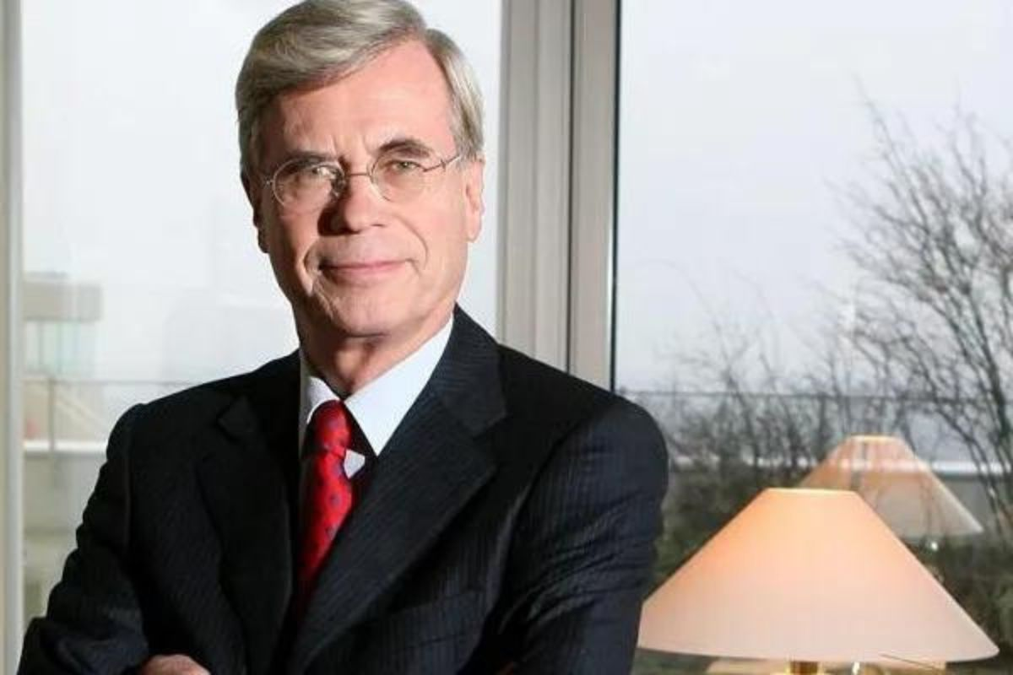
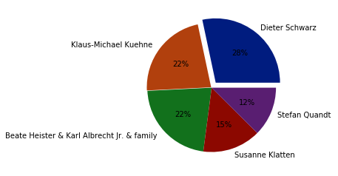
Dieter Schwarz is the Top Billionaires in Germany

Slide 33
Q13.
Which Person has the highest NetWorth

Slide 34
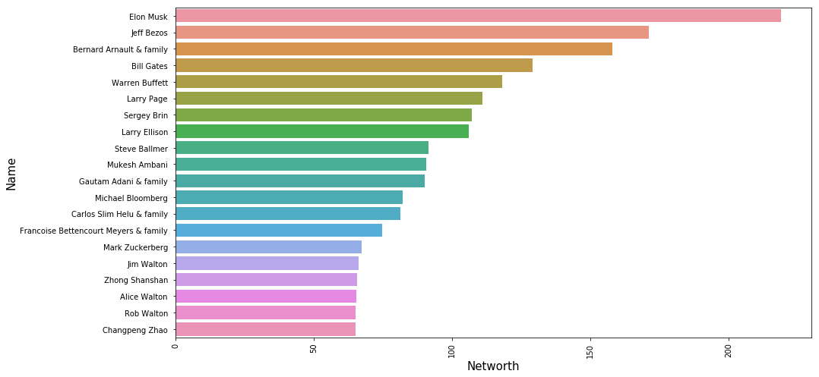
Elon Musk has the highest NetWorth compared to others

Slide 35




Q14.
Which Source has the highest NetWorth

Slide 36
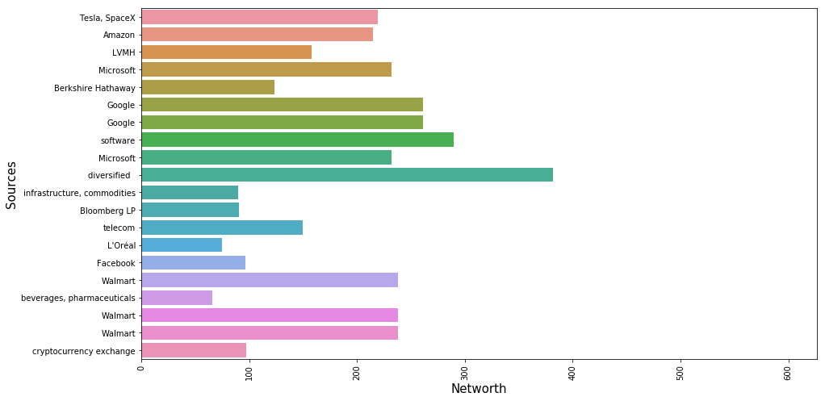
Diversified has the highest NetWorth compared to others

Slide 37
CONCLUSION
United States is the top most billionaires compared to other countries
Most of Billionaires belong to the age group of 50-70
Kevin David Lehmann is youngest Billionaires
Most of the Billionaires work on technologies
Mukesh Ambani is the Top Billionaires in India
Elon Musk is the Top Billionaires in United States
Zhong Shanshan is the Top Billionaires in China
Vladimir Lisin is the Top Billionaires in Russia
Dieter Schwarz is the Top Billionaires in Germany
Elon Musk has the highest NetWorth compared to others
Diversified has the highest NetWorth compared to others

Slide 38

Thank You

